Slide 1
STAT131
Binomial Models

Slide 2
Lecture Outline
Mathematics needed
  FactorialNotation
  Combinations
Introduction to the Binomial Model
Review of Discrete Random Variables

Slide 3
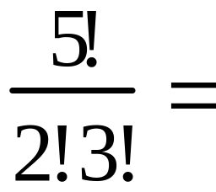
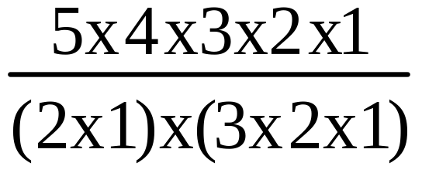
Factorial Notation
n! = n(n-1)x(n-2)x(n-3)x…x1
0! by definition is 1
5!=5x4x3x2x1
7!=
7x6x5x4x3x2x1
Cancel before multiplication
2
=10

Slide 4
Number to power of 0
a⁰ =1 (a is any real number)
2⁰ =1

Slide 5
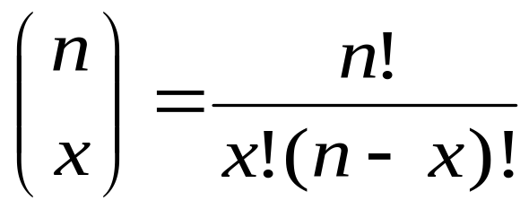
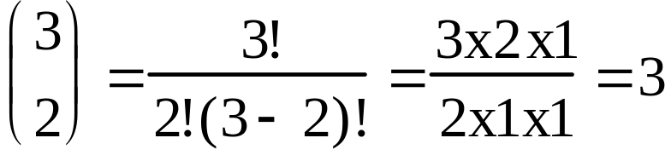
Combinations
x objects selected from n distinct objects
An example: A calibration study needs to be
conducted to see if the readings on 3 test machines
are giving similar results. In how many ways can 2
of the 3 be selected for the initial investigation?
n=3
x=2
(Order is not important, Ans=3 ways)

Slide 6

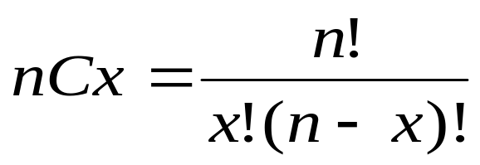
Combinations
The number of ways in which x objects can be selected from a set of n distinct objects is
Sometimes expressed as

Slide 7

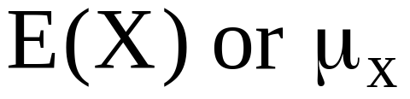
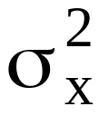
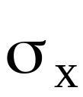
Review of symbols
Centre
Spread
Variance
Spread
Standard
Deviation
Sample
Population Model
Random Variable
S_{x}²
S_{x}

Slide 8
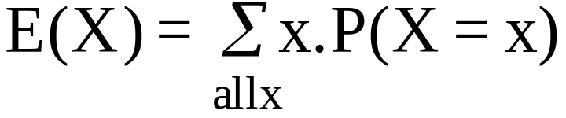
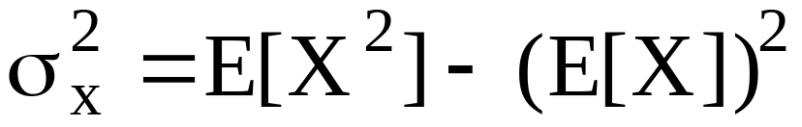
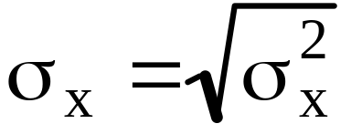
Review of how to calculate
Centre
Spread
Variance
Spread
Standard
Deviation
Sample
Population Model
Random Variable
S_{x}²
S_{x}

Slide 9
Introducing the Binomial Distributions

Slide 10
Binomial Model
The random variable, X, is binomially distributed if X is the number of successes in the n trials and the following conditions hold
The experiment involves a sequence of a fixed number
  of “trials” n
Each trial results in one of two outcomes: “success” or “failure”.
The probability of success, p , is the same for each trial
The trials are conducted independently of one another

Slide 11
Binomial
When X has a binomial distribution with parameters n independent and p (probability of success on any one trial) it is often symbolised by
  X~B(n, p)
The random variable X is binomially distributed
with parameters n and p

Slide 12
Binomial model
Given that X, the number of girls born in families of two children that is distributed Binomial ~ (2, 0.5)*. What should we be able to work out about the model?
What is the centre (mean)?
What is the spread?
What is the probability distribution like
  shape?
  P(X=x)?
* And given data we can work out?

Slide 13
Binomial model
Given that X, the number of girls born in families of two children that is distributed Binomial ~ (2, 0.5)*. What should we be able to work out about the model?
Are there any outliers?
Does the data fit the given model?
The probability of being born girl is close to but
not exactly 0.5

Slide 14
Binomial~(2,0.5)
Given that X, the number of girls born in families of two children, is distributed Binomial ~ (2, 0.5). What are the possible outcomes x.
x
0 girls
1 girl
2 girls
To define the probability distribution for X what else is needed?
The probability of each outcome
What must these probabilities sum to?
1

Slide 15
Binomial~(2,0.5)
Use a tree diagram to work out the probabilities of
0 girls, 1 girl, 2 girls in two child families
G
GG
GB
GB
BB
P(0 girls)=1/4
=0.25
G
B
P(1 girls)=2/4
=0.5
B
G
P(2 girls)=1/4
=0.25
B

Slide 16
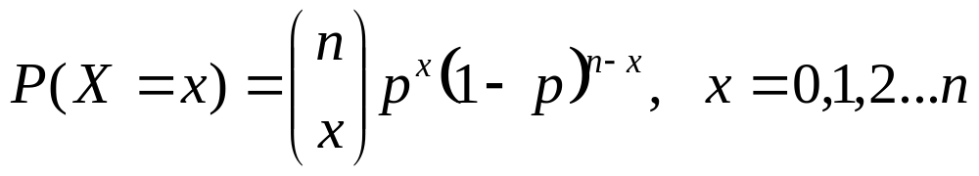
Binomial Model: X~Bin(2, 0.5)
Find P(X=x)
The probability of there being exactly x =0 successes out of the n=2 trials is given by

Slide 17
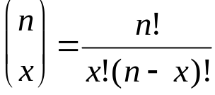
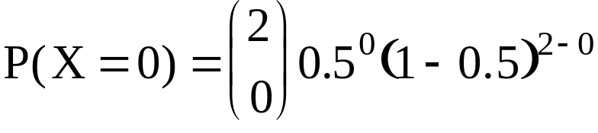
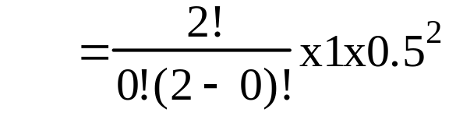

Binomial Model: X~Bin(2, 0.5)
Find P(X=x)
The probability of there being exactly 0 girls out of
the n trials is given by
Noting:

Slide 18
Binomial Model: X~Bin(2, 0.5)
Find P(X=x)
The probability of there being exactly 1 girl out of
the n=2 trials is given by

Slide 19
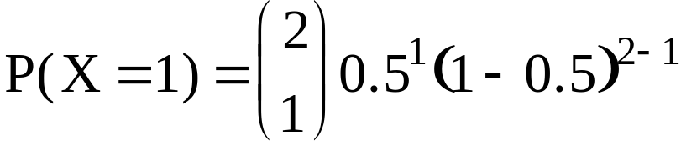
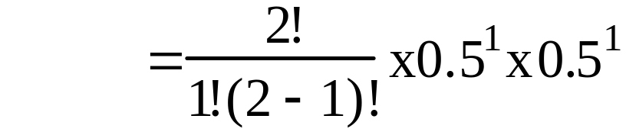

Binomial Model: X~Bin(2, 0.5)
Find P(X=x)
The probability of there being exactly 1 girl out of
the n=2 trials is given by

Slide 20
Binomial Model: X~Bin(2, 0.5)
Find P(X=x)
The probability of there being exactly x=2 girls out of
the n=2 trials is given by

Slide 21
Binomial Model: X~Bin(2, 0.5)
Find P(X=x)
The probability of there being exactly x=2 girls out of
  the n=2 trials can be found simply by
1-(P(X=0)+P(X=1)=1-(0.25+0.5)=0.25

Slide 22
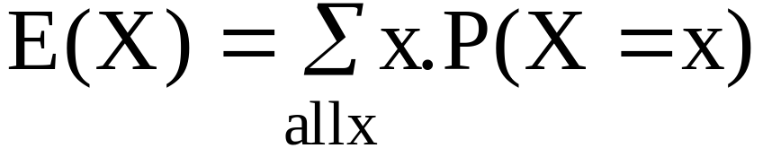
E(X) or mean μ for a discrete random variable
Where
For the example number of girls out of two child families
x P(X=x) x.P(X=x)
E(X)=

Slide 23
E(X) or mean μ for a discrete random variable
Where
For the example number of girls out of two child families
x P(X=x) x.P(X=x)
E(X)=
1.0
0
1
2
0.25
0.5
0.25
0
0.5
0.5
1.0

Slide 24
Discrete Random Variables
When X is the number of success out of n trials and the conditions for a binomial model hold is X a discrete random variable?
Yes the numerical outcomes are 0,1 and 2 ie discrete and
The probabilities associated with each sum to 1.
So we have just found the mean for the random variable X

Slide 25
Binomial Model: E(X) or mean
Simple method
E(X) = np
E(X) =
Probability of being a girl on
any one trial
For our
example
p=0.5
Number of trials
=2 births
2x0.5=1
Which method is the easiest?

Slide 26
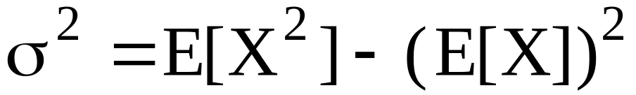

Variance of discrete random variables: General Method
x P(X=x) x² x².P(X=x)
E(X²)=
1.5
0
1
2
0.25
0.5
0.25
0
1
4
0
0.5
1
1.5
So Var(X)=

Slide 27
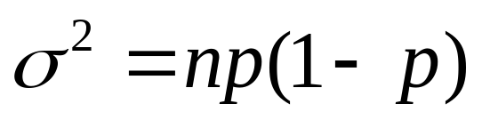
Variance of X~B(2,0.5):
Using information about the binomial
= 2x0.5(1-0.5) = 0.5

Slide 28
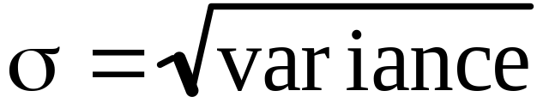
Standard deviation of X given X~B(n,p)
Standard deviation

Slide 29
What other questions can be asked?
Given data ask
  Does the data fit the Binomial (2,0.5) model?
  Do the assumptions for the model appear to hold given the data set

Slide 30
Does the data fit the model
80 families with two children (n_{e}) were randomly selected.
The observed data was as follows
Girls (X) | 0 | 1 | 2 | Total
Observed | 19 | 37 | 24 | n_{e}=80
What is the expected number of families with X=0, 1 and 2 girls?

Slide 31
What is the expected number of families with 0,1 and 2 girls?
For Bin~(2,0.5)
P(X=0)=
P(X=1)=
P(X=2)=
0.25
0.5
0.25
Girls (X) | 0 | 1 | 2 | Total
Observed | 19 | 37 | 24 | n_{e}=80
Expected

Slide 32
What is the expected number of families with 0,1 and 2 girls?
For Bin~(2,0.5)
P(X=0)=
P(X=1)=
P(X=2)=
0.25
0.5
0.25
Girls (X) | 0 | 1 | 2 | Total
Observed | 19 | 37 | 24 | n_{e}=80
Expected | 0.25x80 | 0.5x80 | 0.25x80 | n_{e}=80
P(X=x).n_{e}=number of families expected to have x girls

Slide 33
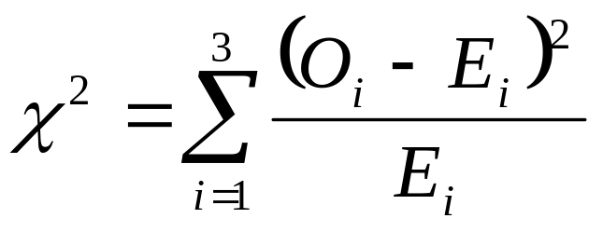
Does the data fit the Bin(2,0.5) model?
Girls (X) | 0 | 1 | 2 | Total
Observed | 19 | 37 | 24 | n_{e}=80
Expected | 20 | 40 | 20 | n_{e}=80
Calculate
If this is bigger than some critical value there is evidence that the data do not fit the binomial(2, 0.5) model

Slide 34
Critical value
Girls (X) | 0 | 1 | 2 | Total
Observed | 19 | 37 | 24 | n_{e}=80
Expected | 20 | 40 | 20 | n_{e}=80

Slide 35
Critical value
Girls (X) | 0 | 1 | 2 | Total
Observed | 19 | 37 | 24 | n_{e}=80
Expected | 20 | 40 | 20 | n_{e}=80
df=n-1
=3-1=2
Use α=0.05
Use chi-square table to get critical value.

Slide 36
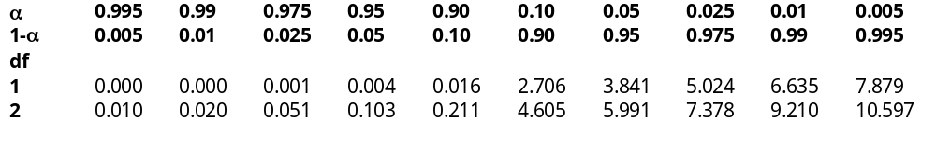
Critical value using χ² tables
df=2
Use α=0.05
Decision Rule: If χ²>5.991 then there is evidence the binomial~(2,0.5)
model does not fit the data.

Slide 37
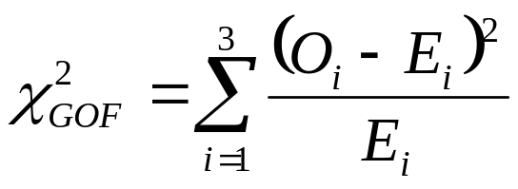
Calculate
Girls (X) | 0 | 1 | 2 | Total
Observed | 19 | 37 | 24 | n_{e}=80
Expected | 20 | 40 | 20 | n_{e}=80
(O-E)
(O-E)²
(O-E)²/E

Slide 38

Calculate
Girls (X) | 0 | 1 | 2 | Total
Observed | 19 | 37 | 24 | n_{e}=80
Expected | 20 | 40 | 20 | n_{e}=80
(O-E) | -1 | -3 | 4
(O-E)² | 1 | 9 | 16
(O-E)²/E | 1/20 | 9/40 | 16/20 | 43/40

Slide 39
Conclusion
Conclude: As chi-square calculated value (1.07) is not greater than critical value(5.991), therefore there is sufficient evidence to suggest that the Bin(2,0.5) does fit the data

Slide 40
Question 1
The random variable X is B(6, 0.42). Find
(a) P(X = 6) (b) P(X = 4)
Question 2
The probability that a person supports Party A is 0.6. Find the probability that in a randomly selected sample of 8 voters there are (a) exactly 3 who support Party A, (b) more than 5 who support Party A.
Question 3
The probability that a pen drawn at random from a box of pens is defective is 0.1. If a sample of 6 pens is taken, find the probability that it will contain (a) no defective pens, (b) 5 or 6 defective pens, (c) less than 3 defective pens.

Slide 41
Question 4
10% of the articles from a certain production line are defective. A sample of 25 articles is taken. Find the expected number of defective items and the standard deviation.
Question 5
It is known that 20% of potatoes in a large stock are rotten. A random sample of 12 potatoes is to be taken . Find the probability that this sample will contain
a) 3 rotten potatoes. b) at most 3 rotten potatoes.

Slide 42

Question 6
The following table lists the probability distribution of the number of breakdowns per week for a machine based on past data.
Find the probability that the number of breakdowns for this machine during a given week is:
exactly 2 b) 0 to 2 c) more than 1
d) at most 1

Slide 43
100 machines with 3 breakdowns (n_{e}) were randomly selected.
The observed data was as follows
Breakdowns (X) | 0 | 1 | 2 | 3
Observed | 25 | 35 | 25 | 15
e) What is the expected number of machines with X=0,1, 2
and 3 breakdowns? Does the data fits the model? Use 0.05
significance level.

